Slide 1
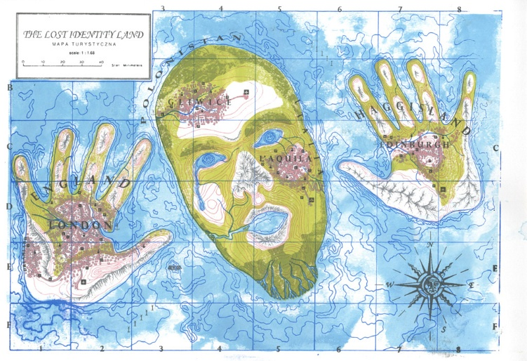
IDENTITY

Slide 2
WHAT IS IDENTITY?
What does identity mean to you?
What might a work of art look like that deals with identity?
What areas of our life do we define ourselves?
Can identity be limiting?
What is an identity crisis?

Slide 3
FIRST STANZA
I am (2 special characteristics you have)
I wonder (something of curiosity)
I hear (an imaginary sound)
I see (an imaginary sight)
I want (an actual desire)
I am (the first line of the poem repeated)
SECOND STANZA
I pretend (something you actually pretend to do)
I feel (a feeling about something imaginary)
I touch (an imaginary touch)
I worry (something that bothers you)
I cry (something that makes you sad)
I am (the first line of the poem repeated)
THIRD STANZA
I understand (something that is true)
I say (something you believe in)
I dream (something you dream about)
I try (something you really make an effort about)
I hope (something you actually hope for)
I am (the first line of the poem repeated)

Slide 4
Does anyone want to share their poem?

Slide 5
I AM POEM
What was the easiest line to write?
What was the hardest line to write?
Do you think that someone somewhere in the world could have some of the same lines as you?
Would this poem be different if you had written it 5 years ago? Will it be different 5 years from now?

Slide 6
Turn to a partner and choose 5 things to answer in your workbook, share
Family
Economic
Race
Gender
Personal Interests
Geographical
Age
Health/Body
Aesthetic
Religion
Ai Wei Wei

Slide 7
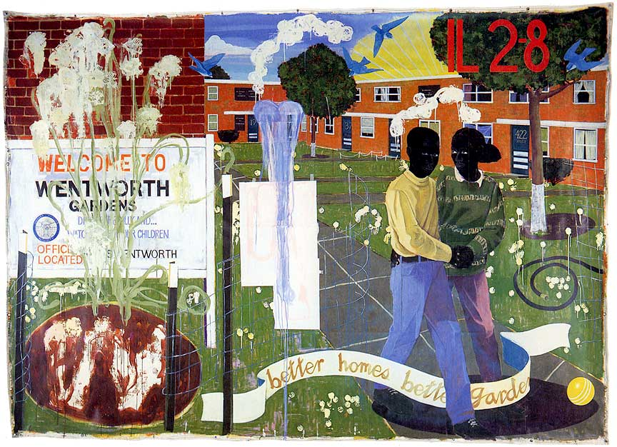
DICTIONARY DEFINITION
The state or fact of remaining the same one or ones, as under varying aspects or conditions.
Kerry James Marshall

Slide 8
ARTISTS USING IDENTITY IN ART
Kerry James Marshall *
Maya Lin
Louise Bourglois
Ai Wei Wei *
Georgia O’Keefe *
Cindy Sherman
Bruce Nauman *

Slide 9
Kerry James Marshall
Born in Birmingham, Alabama
Painter and Sculptor

Slide 10
Ai Wei Wei
Chinese Contemporary Artist
Works with sculpture, installation pieces, architecture, curating, photography, film, and social, political and cultural criticism

Slide 11
Georgia O’keefe
Worked in New Mexico part of nearly every year from 1929 and 1949
Collected rocks and bones

Slide 12
How did Nauman incorporate identity into his artwork?
What was an important part of his process?

Slide 13
THINK ABOUT
How do you define identity?
How do you associate identity with yourself?
What are some things that you identify with?
Who do you show artwork to?
Who do you make artwork for?
Does identity always show up in art?
Can a person’s identity change throughout his/her art career?
Where have you seen identity in your art?

Slide 14
FOR NEXT CLASS
Bring in:
Watercolor Brush
Containers (if available)
Watercolor paper (the sooner the better)

